Slide 1




TimeAlly PET ( Personal Era Swap Teller )
Era Swap Token is subject to Market Risk. Please read Era Swap Utility Token Whitepaper , Era Swap Life T & C* before participating Applicable only for Eraswappers
This is only for internal circulation purpose only

Slide 2
















Sports
Goal Achievement
Travel
Health & Fitness
Real Estate
There is always an opportunity in this beautiful world…
Family Milestones
Market Growth
Happiness
Growth & Success
Nature
Peace of Mind
Celebration
Discounts
Marriage
Education
GDP Growth
Era Swap Token is subject to Market Risk. Please read Era Swap Utility Token Whitepaper , Era Swap Life T & C* before participating Applicable only for Eraswappers
This is only for internal circulation purpose only

Slide 3



















Banks Shutdown
Solitude
Natural Disaster
Home Less
Theft
Mishap
Food Crisis
Uncertain Demise
Life Uncertainities
Security Issues
Illness & Disabilities
Living too long
Political crisis
Global Warming
Unemployment
Disputes
War
Orphanage
Market Crash
Inflation
Era Swap Token is subject to Market Risk. Please read Era Swap Utility Token Whitepaper , Era Swap Life T & C* before participating Applicable only for Eraswappers
This is only for internal circulation purpose only

Slide 4

WHAT comes to your mind when you think of PET?
Happiness
Loyalty
Caring
Time Bound
Transparent
Guard
Programmable
Tool
Certainty
Flawless
Companion
Smart
Joy
Trustless
Solicitate
Consistent
Wealth
Will
Time Bound
Legacy
Era Swap Token is subject to Market Risk. Please read Era Swap Utility Token Whitepaper , Era Swap Life T & C* before participating Applicable only for Eraswappers
This is only for internal circulation purpose only

Slide 5

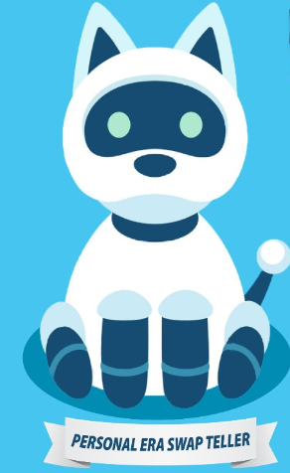
There is one thing which always stays with you……
Adopt TimeAlly PET
(Personal Era Swap Teller)
Disrupting uncertainty….
Empower your journey of life with unerasable Blockchain Based Smart Contract
Era Swap Token is subject to Market Risk. Please read Era Swap Utility Token Whitepaper , Era Swap Life T & C* before participating Applicable only for Eraswappers
This is only for internal circulation purpose only

Slide 6


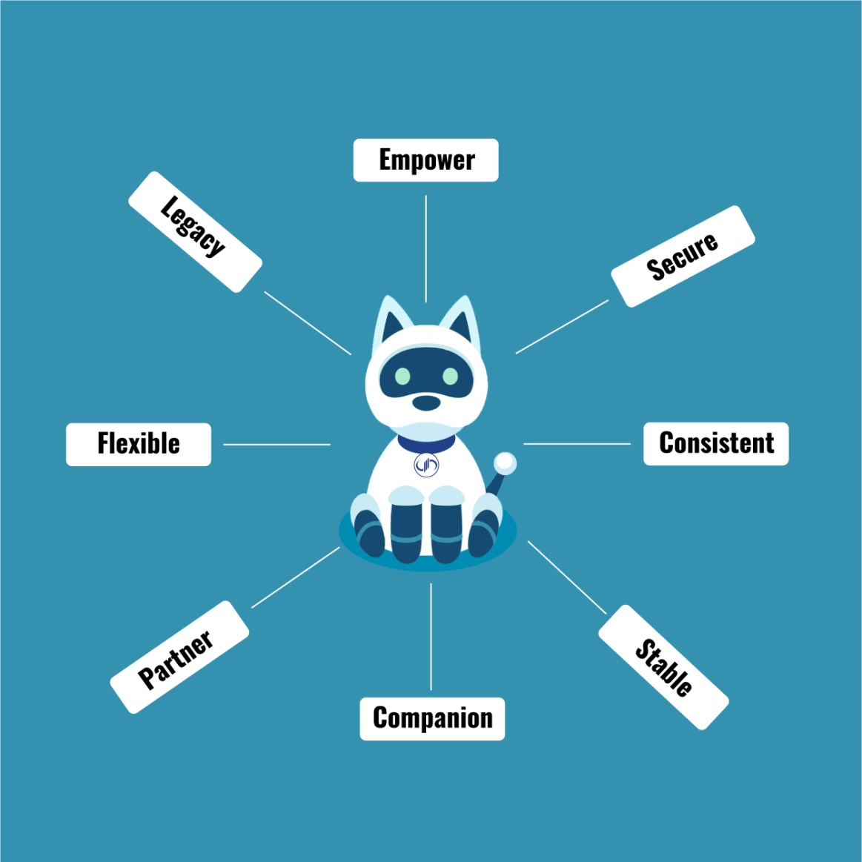

TimeAlly PET (Personal Era Swap Teller) Plan is Guaranteed by Smart Contract
Companion: Guarantees 50% additional support for your Monthly accumulation goals.
Partner: Assures Monthly annuity gain consistently for 5 Annuity Years based on your Monthly Goals achievement
Returns of Premium: Pet provides smart contract based safety, security & stability of your accumulation & rewards you per predefined set of rules
Empower: Pet provides you complete control & transparency of your Monthly Accumulations & returns
Flexible: You can choose your PET plan as per your Monthly Goals & expected gains to meet your milestones.
Legacy: You can add nominees & pass on your legacy to loved ones.
Era Swap Token is subject to Market Risk. Please read Era Swap Utility Token Whitepaper , Era Swap Life T & C* before participating Applicable only for Eraswappers
This is only for internal circulation purpose only

Slide 7
Why TimeAlly Personal Era Swap Teller (PET)
PET Annuity Chart in ES
Monthly Annuity Guaranteed by PET Smart Contract
Will receive Annuity return % on ES staked every month for the same month in next 5 years
PET Bonus
PET Bonus on total ES staked of Accumulation Year gets released timely in 12 equal intervals if all the monthly target commitments are achieved every month (* conditions apply)
PET Bounty
PET shall stake equal count of ES every month as per your stakings for that corresponding month. PET will contribute 50% Bounty of your Monthly target Commitment Plan Selected.
(* conditions apply)
Limited Period Solution
PET is limited period Solution applicable for 20000000 ( 20 Million ES).
Monthly PET staking for 12 months (ES) | PET Bounty will accumulate equal ES as per SAP each corresponding month | Monthly Annuity Return in ES every month for 5 years
500 to 999 | 500 to 999 | 10%
1000 to 2499 | 1000 to 2499 | 10.5%
2500 to 4999 | 2500 to 4999 | 11%
5000 to 9999 | 5000 to 9999 | 11.5%
10000 and above | 10000 and above | 12%
The annuity return % is purely based on the month staking commitment for the subject to 12 months
All the percentages are purely based on number of ES staked in PET plan.
Please refer to the terms and conditions and the Ready Reckoner for more details.
Era Swap Token is subject to Market Risk. Please read Era Swap Utility Token Whitepaper , Era Swap Life T & C* before participating Applicable only for Eraswappers
This is only for internal circulation purpose only

Slide 8
Ready Recknor Chart for PET with
10000 ES Minimum Staking Commitment, Annuity Gain 12%
Era Swap Token is subject to Market Risk. Please read Era Swap Utility Token Whitepaper , Era Swap Life T & C* before participating Applicable only for Eraswappers
This is only for internal circulation purpose only

Slide 9

LEGACY
Appointee:
Appointee is the custodian who can facilitate preponement of benefits to the nominee.
Any number of appointees can be added. With the approval of min 51% appointee, the appointee can prepone the benefits for the nominee in case the staker doesn’t withdraw benefits continuously for 6 months. The appointee can vote any anytime. If staker doesn`t withdraw benefits up to 6 months then with the consensus of appointees, nominees could be able to withdraw before the 1-year waiting period criteria.
Nominee:
Any number of nominees can be added by the staker. A nominee who gets the benefit of the plan in case, the staker doesn’t withdraw benefit continuously for 12 months. If the staker doesn`t withdraw benefits till 1 year, then nominee can withdraw these benefits ( in case there is no appointee selected). Any Nominee can also deposit SAP on behalf of the staker
Era Swap Token is subject to Market Risk. Please read Era Swap Utility Token Whitepaper , Era Swap Life T & C* before participating Applicable only for Eraswappers
This is only for internal circulation purpose only

Slide 10
Personal Era Swap Teller (PET) Smart Contract Salient Features
Important Smart Contract Conditions for Stakers
PET Starts with Systematic Accumulation Plan (SAP) of minimum 500 ES commitment and above ( Please refer to PET Annuity Chart ) . PET Bounty will accumulate equal count of ES as per Monthly Target Commitment achieved as per the Staker
PET Bonus will be released in 12 equal intervals of 5 months each over a period of 5 years as per the Monthly Target Commitment achievement in accumulation year. The PET Bonus pertaining to the 1st month shall be awarded on the 60th month of Annuity, the 2nd month shall be awarded on the 55th month of Annuity, correspondingly the 12th month shall be provided on the end of 5th month of Annuity.
Monthly Target commitment
Monthly target commitment refers to the total ES to be staked within 30 days 10 hours. One needs to select his Monthly target commitment from the annuity chart at the start of the plan.
Monthly Target Achievement Benefits
The staker has the flexibility to stake within 30 days 10 hours till the next window opens. The staker will have to meet the Monthly Target commitment to receive the PET Bonus as well as the PET Bounty
Top-ups
If the user stakes more than the monthly target commitment he/she shall receive 50% of the PET Bounty on the staking above his desired Monthly Target Commitment.
Example: User has decided his limit of 5000 ES and he/she stakes 2000 ES + 2000 ES + 6000 ES in 3 installments within 30 Days 10 hours. The total ES staked in PET is 10000 ES which will shall imply that he/she has achieved his/her target for the month and he/she shall receive a PET Bounty of 5000 ES + 2500 ES.
Passing PET Target Commitment %
The Passing PET target commitment will be minimum 50% of the Monthly target commitment of ES to qualify for PET Bonus. If the monthly target commitment is not achieved and PET target commitment is achieved then the user shall be provided with the PET Smart Contract Contribution but shall not be awarded the PET Bonus and those respective tokens shall be burned for the corresponding month.
Example: If the monthly target of commitment is 10000 ES and the user stakes 5000ES that means he/she has achieved PET Target Commitment by staking minimum 50%. He /She shall avail on PET Smart Contract Contribution of 5000ES but he/she shall qualify for the PET Bonus.
Default Monthly Commitment
If the staker is unable to reach 50% of the monthly Target Commitment ES then he/she shall not qualify for PET Bounty nor shall he qualify for the PET bonus. The total staking ES count shall carry forward to the following month and a default shall be considered for that corresponding month.
Example: Staker defaults to achieve Monthly Target Commitment for 11 months then, he/she will not get 11 installments PET Bonus. He/She will receive PET bonus corresponding to 1 month on the 12th Month of 5th Annuity Year.
Single Lumsum Staking
The staker has the ability to make the entire commitment of 12 months in a single transaction. He/She can avail this option in the first month only if he/she has not staked in that particular PET previously.
Era Swap Token is subject to Market Risk. Please read Era Swap Utility Token Whitepaper , Era Swap Life T & C* before participating Applicable only for Eraswappers
This is only for internal circulation purpose only

Slide 11


Plan Your GOALS
Planned GOAL…
Unplanned GOAL…
Era Swap Token is subject to Market Risk. Please read Era Swap Utility Token Whitepaper , Era Swap Life T & C* before participating Applicable only for Eraswappers
This is only for internal circulation purpose only

Slide 12
TimeAlly PET 10000 ES Illustration for 12 Months
Era Swap Token is subject to Market Risk. Please read Era Swap Utility Token Whitepaper , Era Swap Life T & C* before participating Applicable only for Eraswappers
This is only for internal circulation purpose only

Slide 13
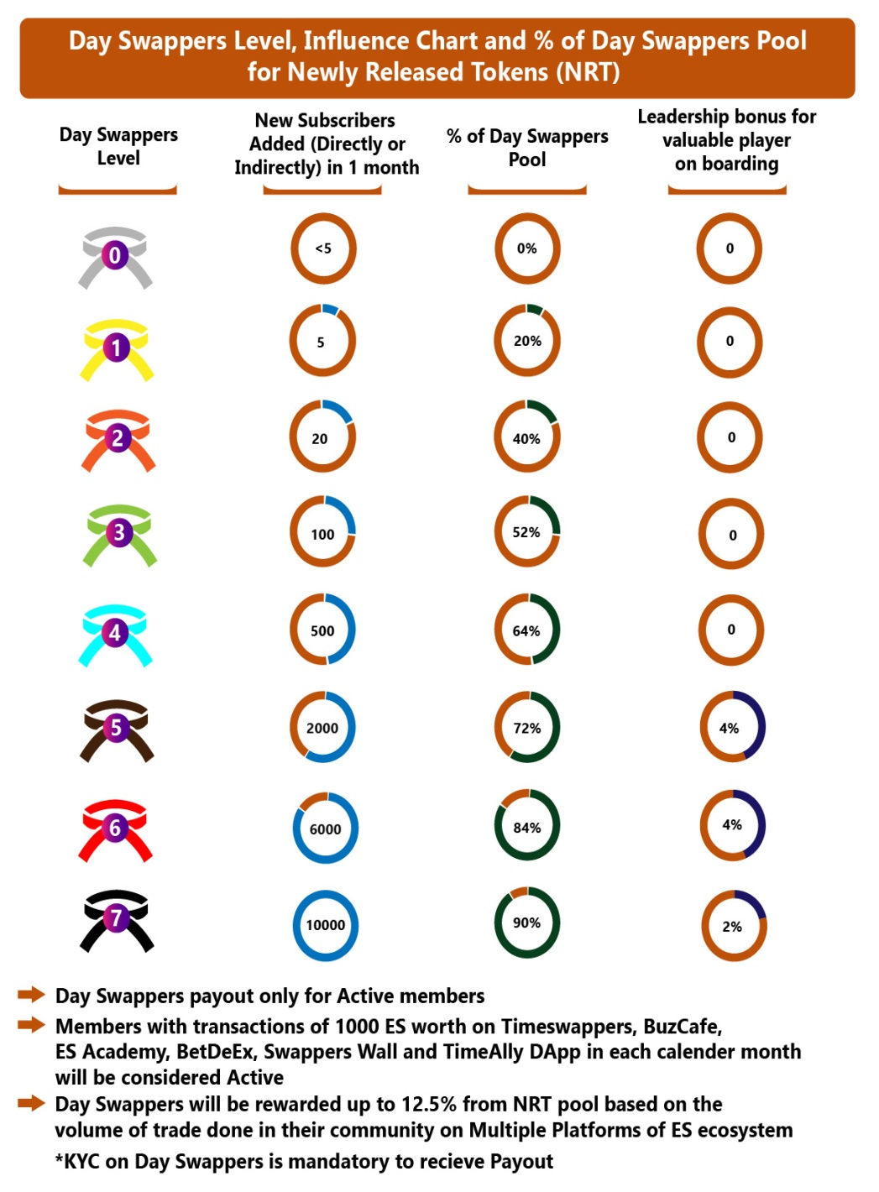
Day Swappers Bounty
Direct Bounty (Introducer) in ES | Bounty as per Day Swappers Tree | Day Swappers Reward Criteria
5% | 5% | Rewards on Monthly ES Stacked for 1 Year
1% | 1% | Annuity for 5 Years
Day Swappers Benefit calculation as per ES Staked for the corresponding month and annuity received for the corresponding month.
The maximum benefit in Day Swappers Tree bounty is given to the Black Belt Day Swappers which is the highest in tree.
Monthly PET staking for 12 months (ES) | Direct Bounty (Introducer) in ES | Bounty as per Day Swappers Tree
500 to 999 | 5% | 5%
1000 to 2499 | 6% | 5%
2500 to 4999 | 7% | 5%
5000 to 9999 | 8% | 5%
10000 and above | 9% | 5%
Era Swap Token is subject to Market Risk. Please read Era Swap Utility Token Whitepaper , Era Swap Life T & C* before participating Applicable only for Eraswappers
This is only for internal circulation purpose only

Slide 14
Statutory Warning
Digital Assets are extremely high-risk, speculative products. You should be aware of the risks involved and fully consider before participating in Digital assets whether it’s appropriate for you. You should only participate if you are an experienced investor with sophisticated knowledge of financial markets and you fully understand the risks associated with Digital assets. We strongly advise you to take independent professional advice before making any investment or participating in any way.
You should also check what rules and protections apply to your respective jurisdictions before investing or participating in any way. The Creators & community will not compensate you for any losses from trading, investment or participating in any way. You should read whitepaper carefully before participating and consider whether these products are right for you.
Era Swap Token is subject to Market Risk. Please read Era Swap Utility Token Whitepaper , Era Swap Life T & C* before participating Applicable only for Eraswappers
This is only for internal circulation purpose only

